Slide 1

Intro to Deep Learning with applications in Medical Research
Jasper Zhang
VADA Program Summer Institute Workshop
June 19, 2023
Notes:
welcome to the workshop

Slide 2


Slide 3
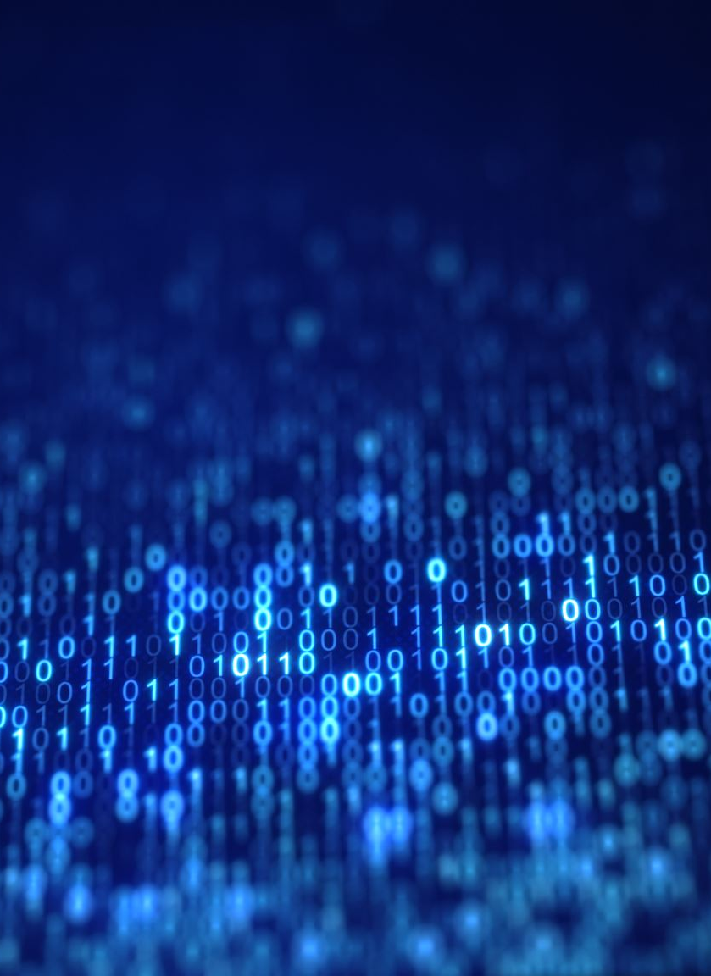
Outline of the Workshop
Part 1:
Intro to Deep Learning and Image data
Coding Task 1: Cats and Dog Classification CNN
Part 2:
Extend single measurement to repeated measurements
Coding Task 2: Next Frame Prediction
Part 3:
Deep Learning in Medical Research Applications
Q and A

Slide 4

Components of Workshop
Interview Questions
Introduction to Basic Knowledge in Deep Learning
Sample Interview Questions for Machine Learning Engineer Positions
Hands-on Code Example to Demonstrate Practical Implementation
Strategies for Adapting Deep Learning Techniques to Image Data in Your Research
This Photo by Unknown Author is licensed under CC BY-SA-NC
Notes:
Thank you for spending one hour on the First Monday after the final exam week. Other than some traditional course materials you learnt before. On many slides, I'll show you what kind of quesitons you gonna be asked during an interview, especially for a Data Science or Machine Learning Eng position.

Slide 5
Part 1: Intro to Deep Learning

Slide 6
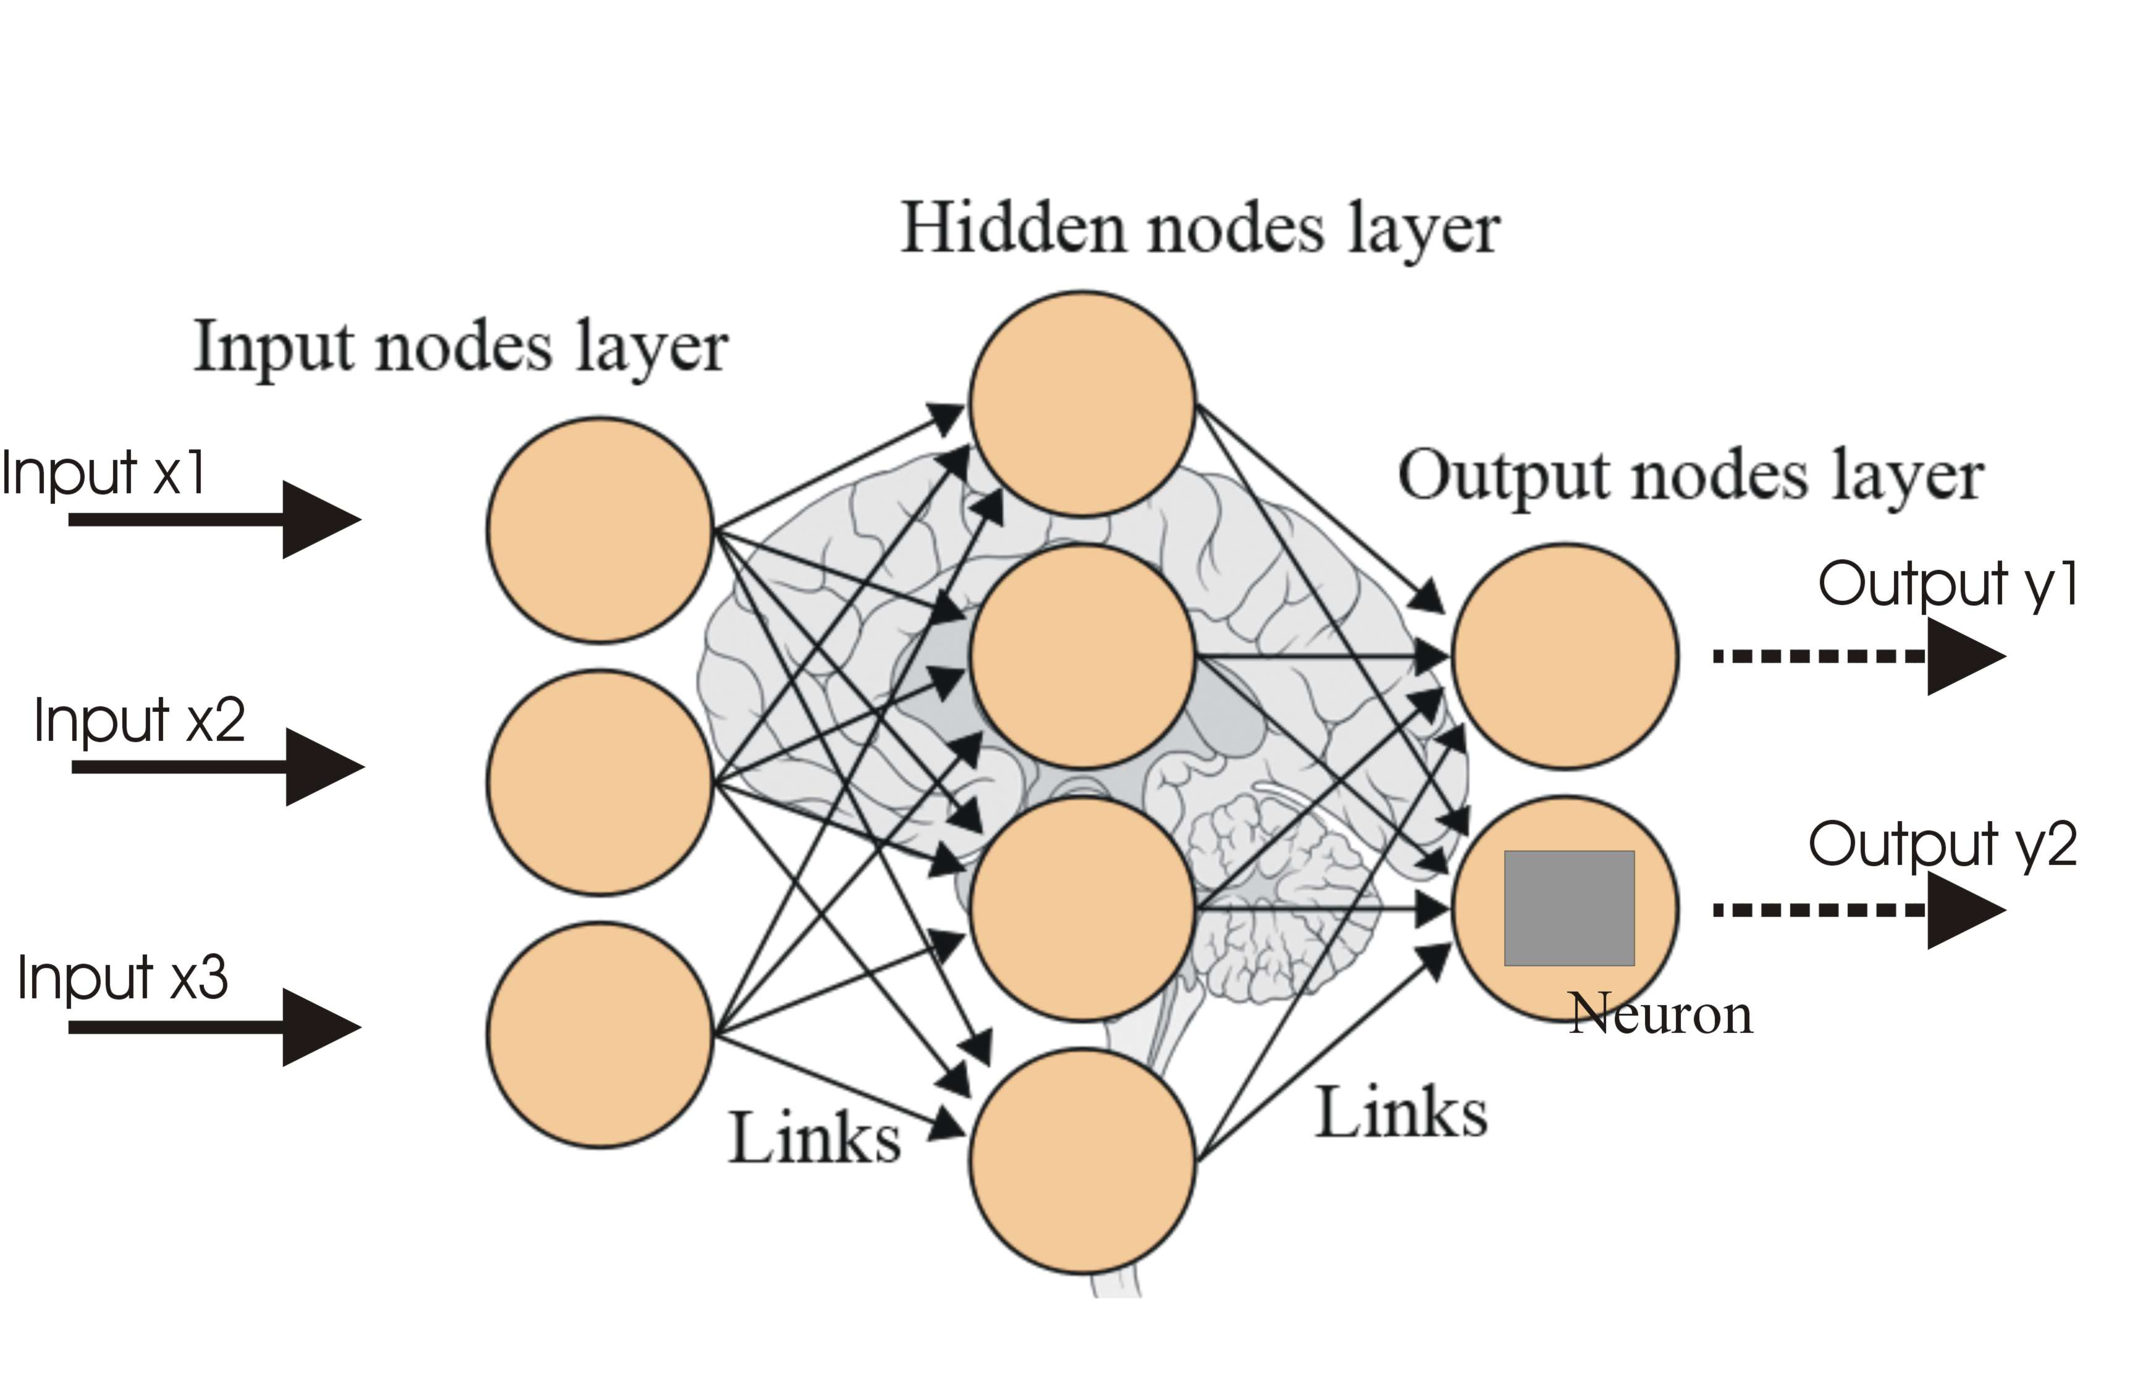
Introduction to Deep Learning
What is Deep Learning?
How it differs from Machine Learning?
Deep learning, A subset of machine learning
Inspired by the structure and function of the human brain
Automatic feature learning
Traditional machine learning: hand-engineered features by domain expertise, time consuming.
This Photo by Unknown Author is licensed under CC BY-SA
Notes:
Deep Learning is a subfield of machine learning that focuses on using artificial neural networks to model and solve complex problems. It is inspired by the structure and function of the human brain and can automatically learn hierarchical representations from raw data, which makes it particularly effective for tasks like image recognition, natural language processing, and speech recognition.
The primary difference between deep learning and traditional machine learning is the way they learn features and patterns from data. In traditional machine learning, features are usually hand-engineered, which requires domain expertise and can be time-consuming. On the other hand, deep learning algorithms can automatically learn and extract features from data, requiring minimal manual intervention. Additionally, deep learning models can handle large amounts of data and learn more complex patterns, thanks to their multiple layers of interconnected neurons. However, they may require more computational resources and time to train compared to traditional machine learning models.

Slide 7

Activation Function
What is activation function?
Activation functions decide the output of a neural network neuron based on its inputs.
They add non-linearity to the network, empowering it to learn from complex and intricate data patterns.
The choice of the activation function, such as Sigmoid, ReLU, or Tanh, greatly impacts the learning capability and performance of the neural network.
This Photo by Unknown Author is licensed under CC BY-SA
Notes:
We need activation functions in neural networks to introduce non-linearity into the model. Without them, regardless of the number of layers, the network would behave just like a single-layer perceptron because summing these layers would give another linear function. Non-linearity allows the model to learn from complex patterns in the data, increasing the model's representational power and ability to generalize from the input data.

Slide 8
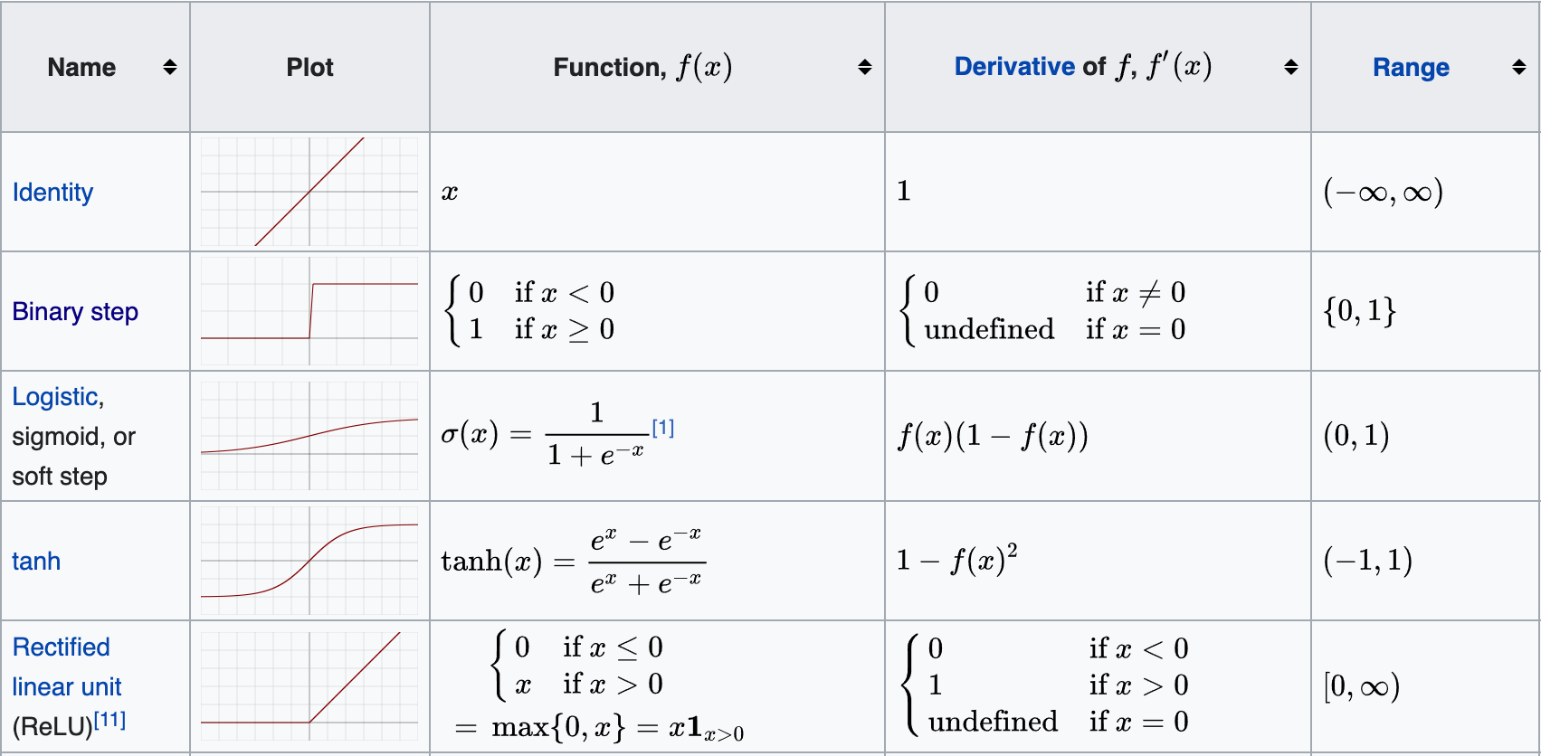
Common Activation Function
Difference Between sigmoid and tanh?
This Photo by Unknown Author is licensed under CC BY
Notes:
Sigmoid vs. Tanh Activation Functions
Sigmoid Function
Output Range: The sigmoid function squashes values between a range of 0 to 1. This can be useful when interpreting the output as a probability.
Gradient: The gradient values of the sigmoid function are always between 0 and 0.25. Consequently, if the network is deep, this can lead to the vanishing gradient problem, where the gradients become too small to effectively adjust the weights and biases.
Zero-Centered: The sigmoid function is not zero-centered, meaning the outputs are always positive. This can potentially lead to slower convergence during optimization.
Tanh Function
Output Range: The tanh function squashes values between -1 and 1, making it zero-centered. As such, it is often preferred over sigmoid for hidden layers in neural networks as the outputs can be negative, zero, or positive, leading potentially to faster convergence during training.
Gradient: Similar to the sigmoid function, the tanh function can also suffer from the vanishing gradient problem in deep networks as the gradient values can become very small.
Zero-Centered: The zero-centered output of the tanh function can make learning easier for the next layer since the updates won't always be in the same direction.
Both sigmoid and tanh functions have their places in deep learning models, but they have been somewhat surpassed by the ReLU function and its variants, which tend to offer better performance for many tasks due to mitigating the vanishing gradient problem.

Slide 9

Supervised Learning
What is Supervised Learning?
Difference Between Classification and Regression
Supervised Learning Task
Known labels/outcome
Classification vs Regression
Categorical Target Variable: filter incoming emails, Spam or not
Continuous Target Variable: housing price
This Photo by Unknown Author is licensed under CC BY-SA
Notes:
Classification is a supervised learning task that involves predicting discrete, categorical labels or classes for input data. The goal is to assign each input data point to one of the predefined categories based on the patterns learned from the training dataset. Examples of classification tasks include email spam filtering (classifying emails as spam or not spam), handwritten digit recognition, and medical diagnosis (identifying a disease based on symptoms).

Slide 10





Deep Learning Tools
Do you have any experience using the DL framework?
What are Deep Learning Tools? These are software libraries and frameworks that streamline the process of creating, training, and implementing deep learning models by providing pre-coded functions, algorithms, and high-level interfaces.
Why Do We Need Them? Deep learning tools make the model-building process more accessible by handling lower-level details, optimizing computations, and offering GPU acceleration and distributed computing capabilities for large-scale models.
This Photo by Unknown Author is licensed under CC BY-NC
This Photo by Unknown Author is licensed under CC BY-SA-NC
This Photo by Unknown Author is licensed under CC BY-SA
This Photo by Unknown Author is licensed under CC BY-NC
This Photo by Unknown Author is licensed under CC BY
Notes:
What are Deep Learning Tools? Deep learning tools refer to software libraries and frameworks that facilitate the creation, training, and implementation of deep learning models. These tools provide pre-coded functions, algorithms, and high-level interfaces that simplify the complex processes involved in deep learning, such as defining layers in a network, backpropagation, or optimization techniques.
Why Do We Need Them? Deep learning tools help reduce the time and complexity involved in building deep learning models. They handle lower-level details and provide a higher level of abstraction, making the process more accessible for both beginners and experts. They also offer optimized and efficient computations for dealing with large datasets, GPU acceleration, and distributed computing for training large and complex models.
Examples of Tool Names: Some of the popular deep learning tools include TensorFlow, Keras, PyTorch, and Caffe. These tools have broad applications and have been used in various areas such as image and speech recognition, natural language processing, and autonomous vehicles. Each tool offers its unique features and capabilities, giving developers a range of options to choose from based on their specific needs.

Slide 11
What is Keras?
High-level neural networks API
Easy-to-use and beginner-friendly
Tensorflow backend
This Photo by Unknown Author is licensed under CC BY-NC
Strength of Deep Learning Python Library
Notes:
Introduce Keras as a high-level neural networks API designed for simplicity and ease of use.
Explain how Keras is beginner-friendly, offering an easy way to build and train deep learning models.
Mention that Keras runs on the Tensorflow backend, which allows for efficient computation and GPU support.
I use Keras for building deep learning models due to its user-friendly interface that enables fast experimentation and prototyping, its modularity and support for popular layers and operations, and the strong community support that continually contributes to the library's development and improvement.

Slide 12

Coding Task 1: Cats and Dog Classification using CNN

Slide 13

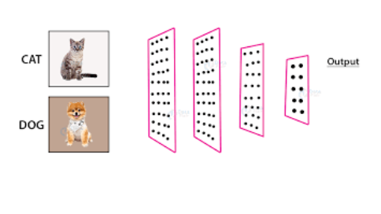
Image Classification Tasks
What is image classification, and can you provide some practical examples of its applications?
Assigning labels to images
Applications: object recognition, facial recognition, medical imaging
Notes:
Image classification is the process of assigning a label or class to an image. This can be done manually, but is often done with machine learning algorithms. Once an image has been classified, it can be search for and retrieved based on the label that has been assigned to it.

Slide 14
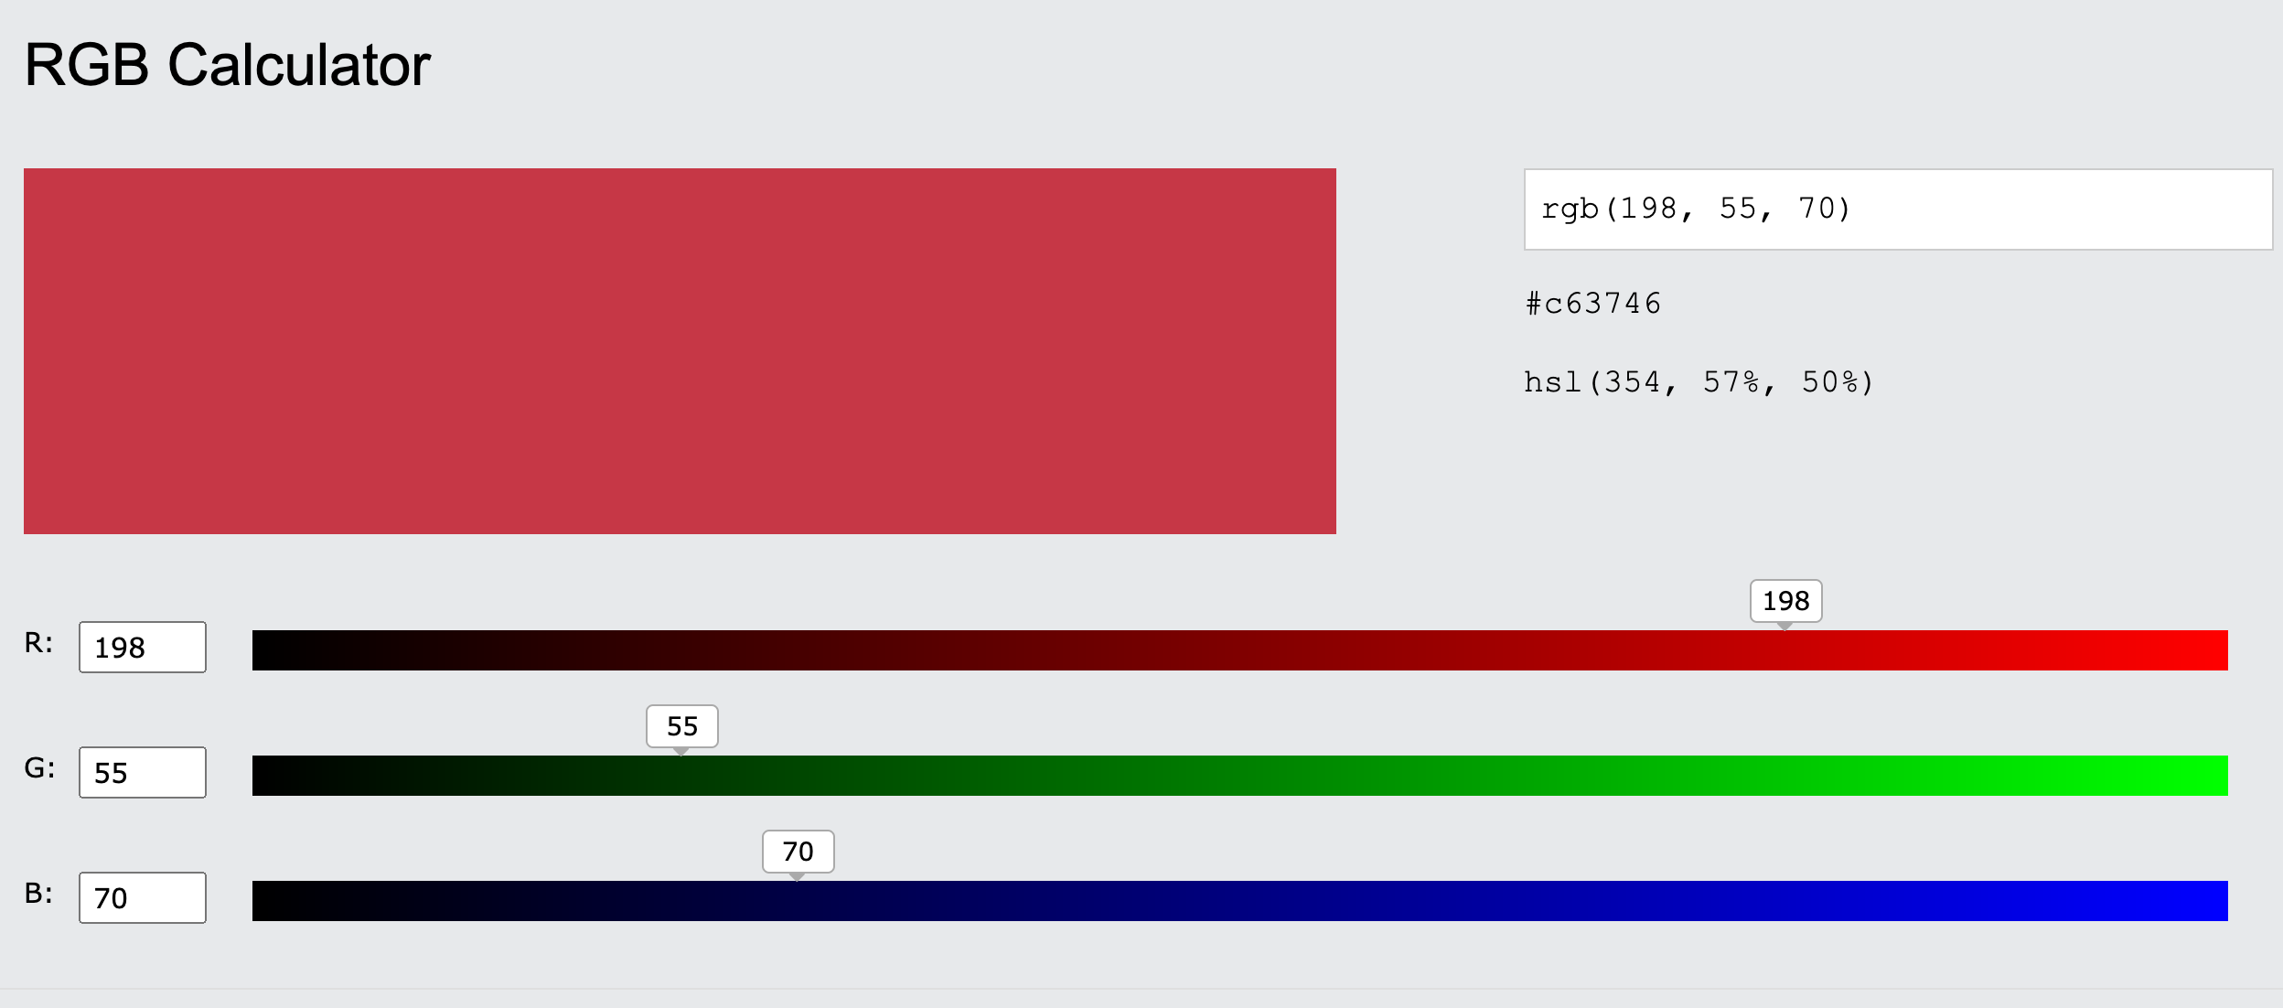
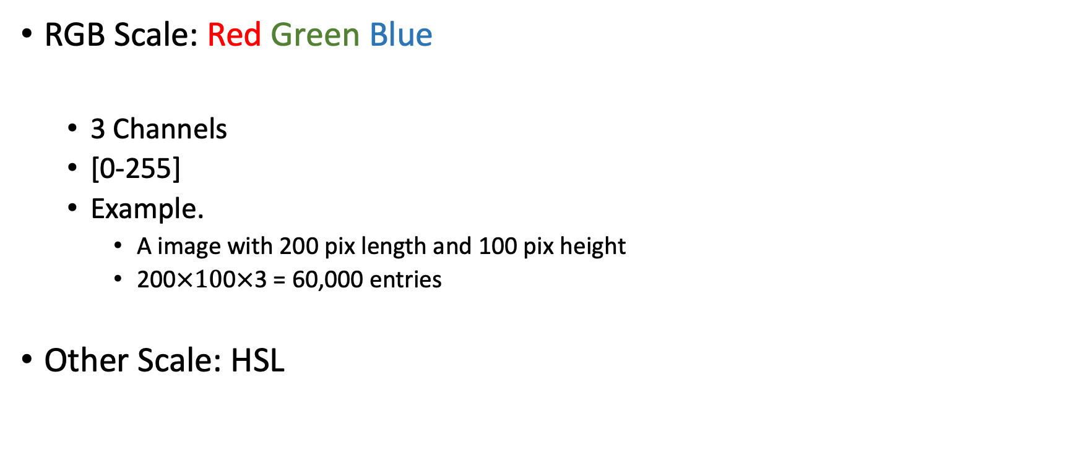
Image Data
What’s the difference between image data and tabular data?
RGB Scale: Red Green Blue
3 Channels
[0-255]
Example.
A image with 200 pix length and 100 pix height
200$×10$0$×$3 = 60,000 entries
Other Scale: HSL
Notes:
Image data and tabular data represent two distinct types of data used in machine learning and data analysis. The main differences between them lie in their structure, characteristics, and the types of problems they are used to address.

Slide 15

Convolutional Neural Networks
Convolutional Neural Networks (CNNs) are a type of deep learning architecture designed to process grid-like data, such as images, by using specialized layers like convolutional and pooling layers.
CNNs excel at learning spatial features and are highly effective for image recognition, classification, and computer vision tasks.
Example
Input 5 x 5
Kernel 3 x 3
Padding: 1
Stride:1
Output: 5 x 5
O = (W - K + 2 * P) / S + 1 5 = (5 – 3 + 2 * 1) + 1
What is CNNs?
This Photo by Unknown Author is licensed under CC BY
Notes:
A Convolutional Neural Network (CNN) is a type of deep learning architecture specifically designed to handle image and grid-like data. It is a specialized type of neural network that focuses on learning spatial hierarchies of features, which makes it highly effective for image recognition, classification, and computer vision tasks.
Input: A 5x5 matrix representing the input data (e.g., an image).
Kernel: A 3x3 matrix, also known as a filter, used to perform the convolution operation on the input data.
Padding: The addition of extra pixels or rows/columns to the input data, usually to preserve the spatial dimensions during convolution.
Stride: The number of steps the kernel moves across the input data during the convolution process.

Slide 16
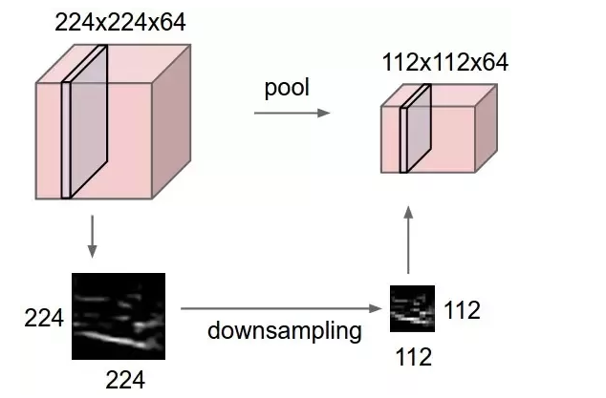
Pooling Layer
Pooing layer vs Convolution layer
Dimensionality Reduction: Pooling reduces the spatial size of the input, lowering computation, memory usage, and parameter count to help prevent overfitting.
Translation Invariance: Pooling ensures feature detection is invariant to their position in the image, increasing model robustness to spatial transformations.
Feature Extraction: Pooling helps extract dominant features, thereby contributing to the feature learning capacity of CNNs.
This Photo by Unknown Author is licensed under CC BY-SA-NC
Notes:
The choice between max pooling and average pooling in a Convolutional Neural Network (CNN) largely depends on the specific task and the nature of the input data. Here are some considerations:
Max Pooling:
Max pooling provides a robust feature detection method, regardless of small translations in the input data. This is because it outputs the maximum activation within a local window, making it invariant to small translations.
It effectively retains the most salient features within a certain window, as it extracts the highest value. This can be especially useful when we care about whether a specific feature is present or not.
However, max pooling can lead to loss of exact spatial information as it only retains the maximum value and discards all other information within the window.
Average Pooling:
Average pooling calculates the average of the activations within a local window. This leads to smooth spatial downsampling where every input value contributes equally to the output.
It retains more information about the input window as compared to max pooling. However, this might also include irrelevant or noise activations, potentially diluting the salient features.
This pooling method can be useful when the presence of different features should contribute equally to the learned representation, rather than only considering the most activated feature.
In practice, max pooling is used more frequently as it tends to give better performance for many tasks. However, the best approach can often only be determined empirically, i.e., by trying out both methods and seeing which one works best for your specific task.

Slide 17
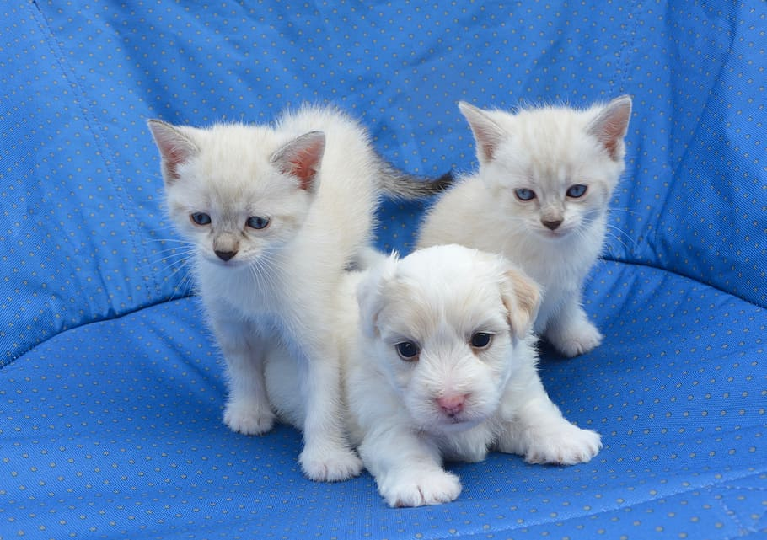


Cats and Dogs Classification Keras Example
Binary classification task
Challenges: variations in appearance
Precautions: data quality, class imbalance
This Photo by Unknown Author is licensed under CC BY-SA
Notes:
Introduce the cats and dogs classification task as a binary classification problem.
Discuss the challenges involved, like variations in appearance
Highlight precautions to consider, such as data quality and class imbalance.

Slide 18
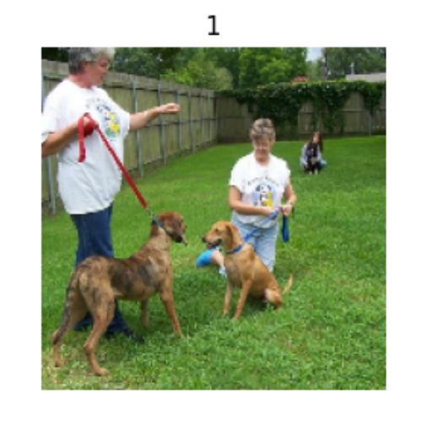
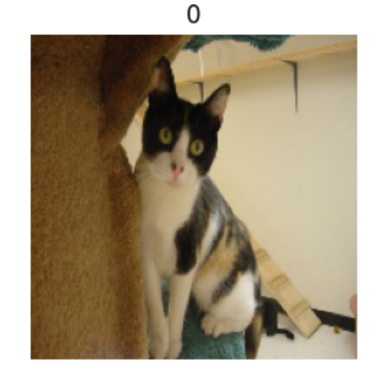
Dataset Introduction
Cats and dogs images
Dataset source: Kaggle
Format: labeled folders, JPEG images
Notes:
Describe the cats and dogs dataset, including its source from Kaggle.
Explain the format and organization of the dataset (labeled folders containing JPEG images).
Mention the number of images and the distribution of classes in the dataset.

Slide 19

Data Preprocessing
What is the purpose of image preprocessing in deep learning?
Data cleaning: removing duplicates, corrupted images
Data augmentation: rotation, flipping, zooming
Resizing and normalizing images
This Photo by Unknown Author is licensed under CC BY
Notes:
Discuss the importance of data preprocessing.
Explain data cleaning steps like removing duplicates and corrupted images.
Describe data augmentation techniques such as rotation, flipping, and zooming.
Mention the importance of resizing and normalizing images for consistent input to the neural network.

Slide 20
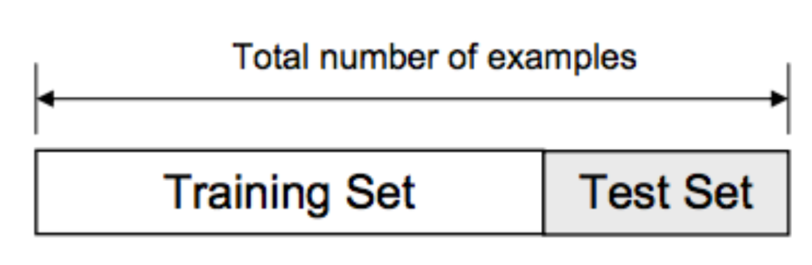
Training, Testing, and Evaluation
Splitting data: training and testing sets
Evaluation metrics: accuracy
Why do you need to split train, test sets?
This Photo by Unknown Author is licensed under CC BY-NC-ND
Notes:
Explain the process of splitting data into training and testing sets for model evaluation.
Splitting a dataset into separate train and test sets is necessary to evaluate the performance of a machine learning model accurately.
It helps to ensure that the model is not overfitting to the training data and can generalize well to new, unseen data.
The train/test split is a common practice in machine learning and is crucial for creating models that are reliable and robust.

Slide 21

Regularization and Dropout
How to show the model’s robustness?
Overfitting is when a model learns the training data too well, capturing noise and outliers in addition to underlying patterns. This leads to poor performance on unseen data as the model fails to generalize effectively.
Underfitting occurs when a model learns too little from the training data, failing to capture all relevant patterns. This results in poor performance on both training and unseen data as the model is overly simplified.
This Photo by Unknown Author is licensed under CC BY-NC
Notes:
Explain the process of splitting data into training and testing sets for model evaluation.
Splitting a dataset into separate train and test sets is necessary to evaluate the performance of a machine learning model accurately.
It helps to ensure that the model is not overfitting to the training data and can generalize well to new, unseen data.
The train/test split is a common practice in machine learning and is crucial for creating models that are reliable and robust.

Slide 22
Batch size and Epoch
Epoch vs iterations?
The batch size is the number of training examples used in one iteration of model training. The selection of batch size can impact both the speed and the stability of the learning process.
An epoch is one complete pass through the entire training dataset. The number of epochs is a hyperparameter that determines how many times the learning algorithm will work through the entire training dataset.
Notes:
Epoch: An epoch is a term used in machine learning and indicates the number of passes of the entire training dataset the machine learning algorithm has completed. If the model has gone through all samples in the dataset one time, that is one epoch.
Iteration: An iteration refers to the number of times the model has gone through a batch of samples. For example, if you have 1000 training samples and you choose a batch size of 100, then the model would have gone through 10 iterations for one epoch.
The distinction is important because you often need multiple epochs to train a machine learning model, as the model learns and improves its predictions with each epoch. However, the model weights can be updated after each iteration. Adjusting the number of epochs and the batch size (and therefore the number of iterations) can have a significant effect on the model's learning process and final performance.

Slide 23
Code Example
Building the neural network with Keras
Compiling the model
Training and evaluating the model
Notes:
Walk the audience through the Keras code for the cats and dogs classification task.
Explain the process of building the neural network using Keras layers and functions.
Discuss model compilation, including the choice of optimizer, loss function, and evaluation metrics.
Show the code for training the model, and discuss the results of the evaluation.

Slide 24
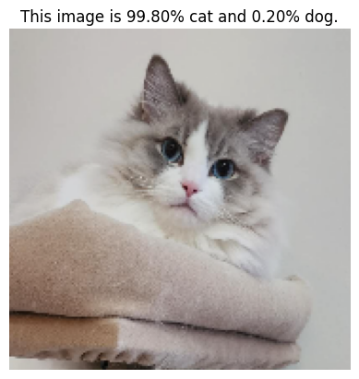
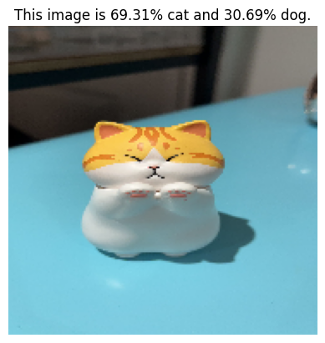
Summary of the Keras Cats and Dogs Code Example
Recap of the code walkthrough
Model performance
Potential improvements
Notes:
Provide a brief recap of the code example, summarizing the main steps involved in building, training, and evaluating the model.
Discuss the model's performance on the classification task and compare it to any existing benchmarks.
Suggest potential improvements to the model, such as using different architectures, more advanced optimization techniques, or additional data preprocessing.

Slide 25
Part 2 Extend Single Measurement to Repeated measurements

Slide 26

What if a single individual has multiple measurements, a collection of records?

Slide 27
Motivation for Sequential Data
Properties of Sequential Data
Sequential data refers to data where the order of the elements carries meaningful information. This could include time series data, sentences in a language, video frames, etc.
Limitations of Traditional Models: Traditional machine learning models often treat data points as independent, disregarding the sequential order. This approach fails to capture sequential data’s rich temporal dynamics and dependencies.
Given these challenges, there is a critical need for specialized models that can understand and leverage the temporal dependencies in sequential data. This need has led to the development of Recurrent Neural Networks (RNNs) and their variants.
Notes:
Walk the audience through the Keras code for the cats and dogs classification task.
Explain the process of building the neural network using Keras layers and functions.
Discuss model compilation, including the choice of optimizer, loss function, and evaluation metrics.
Show the code for training the model, and discuss the results of the evaluation.

Slide 28
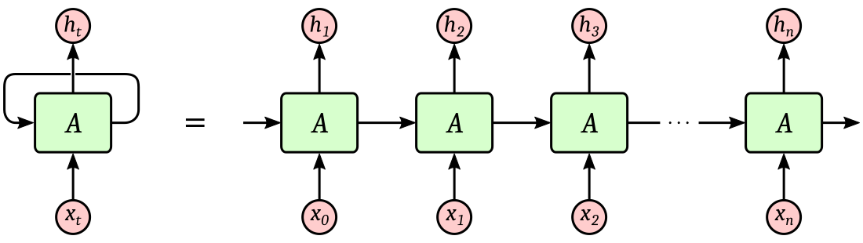
Recurrent Neural Network
What is Vanishing Gradient?
Recurrent Neural Networks (RNNs) are a type of neural network designed to recognize patterns in sequences of data, like text, genomes, handwriting, or spoken words.
Working Mechanism: RNNs incorporate a 'memory' of sorts to capture information about the sequence. This is done through the use of hidden states, which carry information from one step of the sequence to the next.
Challenge: Vanishing Gradient
Notes:
: While RNNs theoretically seem perfect for sequence data, they struggle with long-term dependencies due to the 'vanishing gradient' problem. This refers to the issue where the contribution of information decays geometrically over time, making the learning of long-term dependencies practically impossible.

Slide 29
Long Short Term Memory
LSTM vs RNN
Long Short-Term Memory (LSTM) networks, a type of RNN, are specifically designed to avoid the long-term dependency problem (vanishing gradient problem) that traditional RNNs face.
Understanding LSTM Architecture: LSTMs introduce the concept of gates: input, forget, and output gates. These gates determine what information should be stored, discarded, or outputted at each time step.
Why LSTMs? By controlling the flow of information using these gates, LSTMs have a greater ability to bridge minimal to large time lags by mitigating the vanishing gradient problem. This makes LSTMs extremely valuable for many sequential processing tasks.
Notes:
: While RNNs theoretically seem perfect for sequence data, they struggle with long-term dependencies due to the 'vanishing gradient' problem. This refers to the issue where the contribution of information decays geometrically over time, making the learning of long-term dependencies practically impossible.

Slide 30
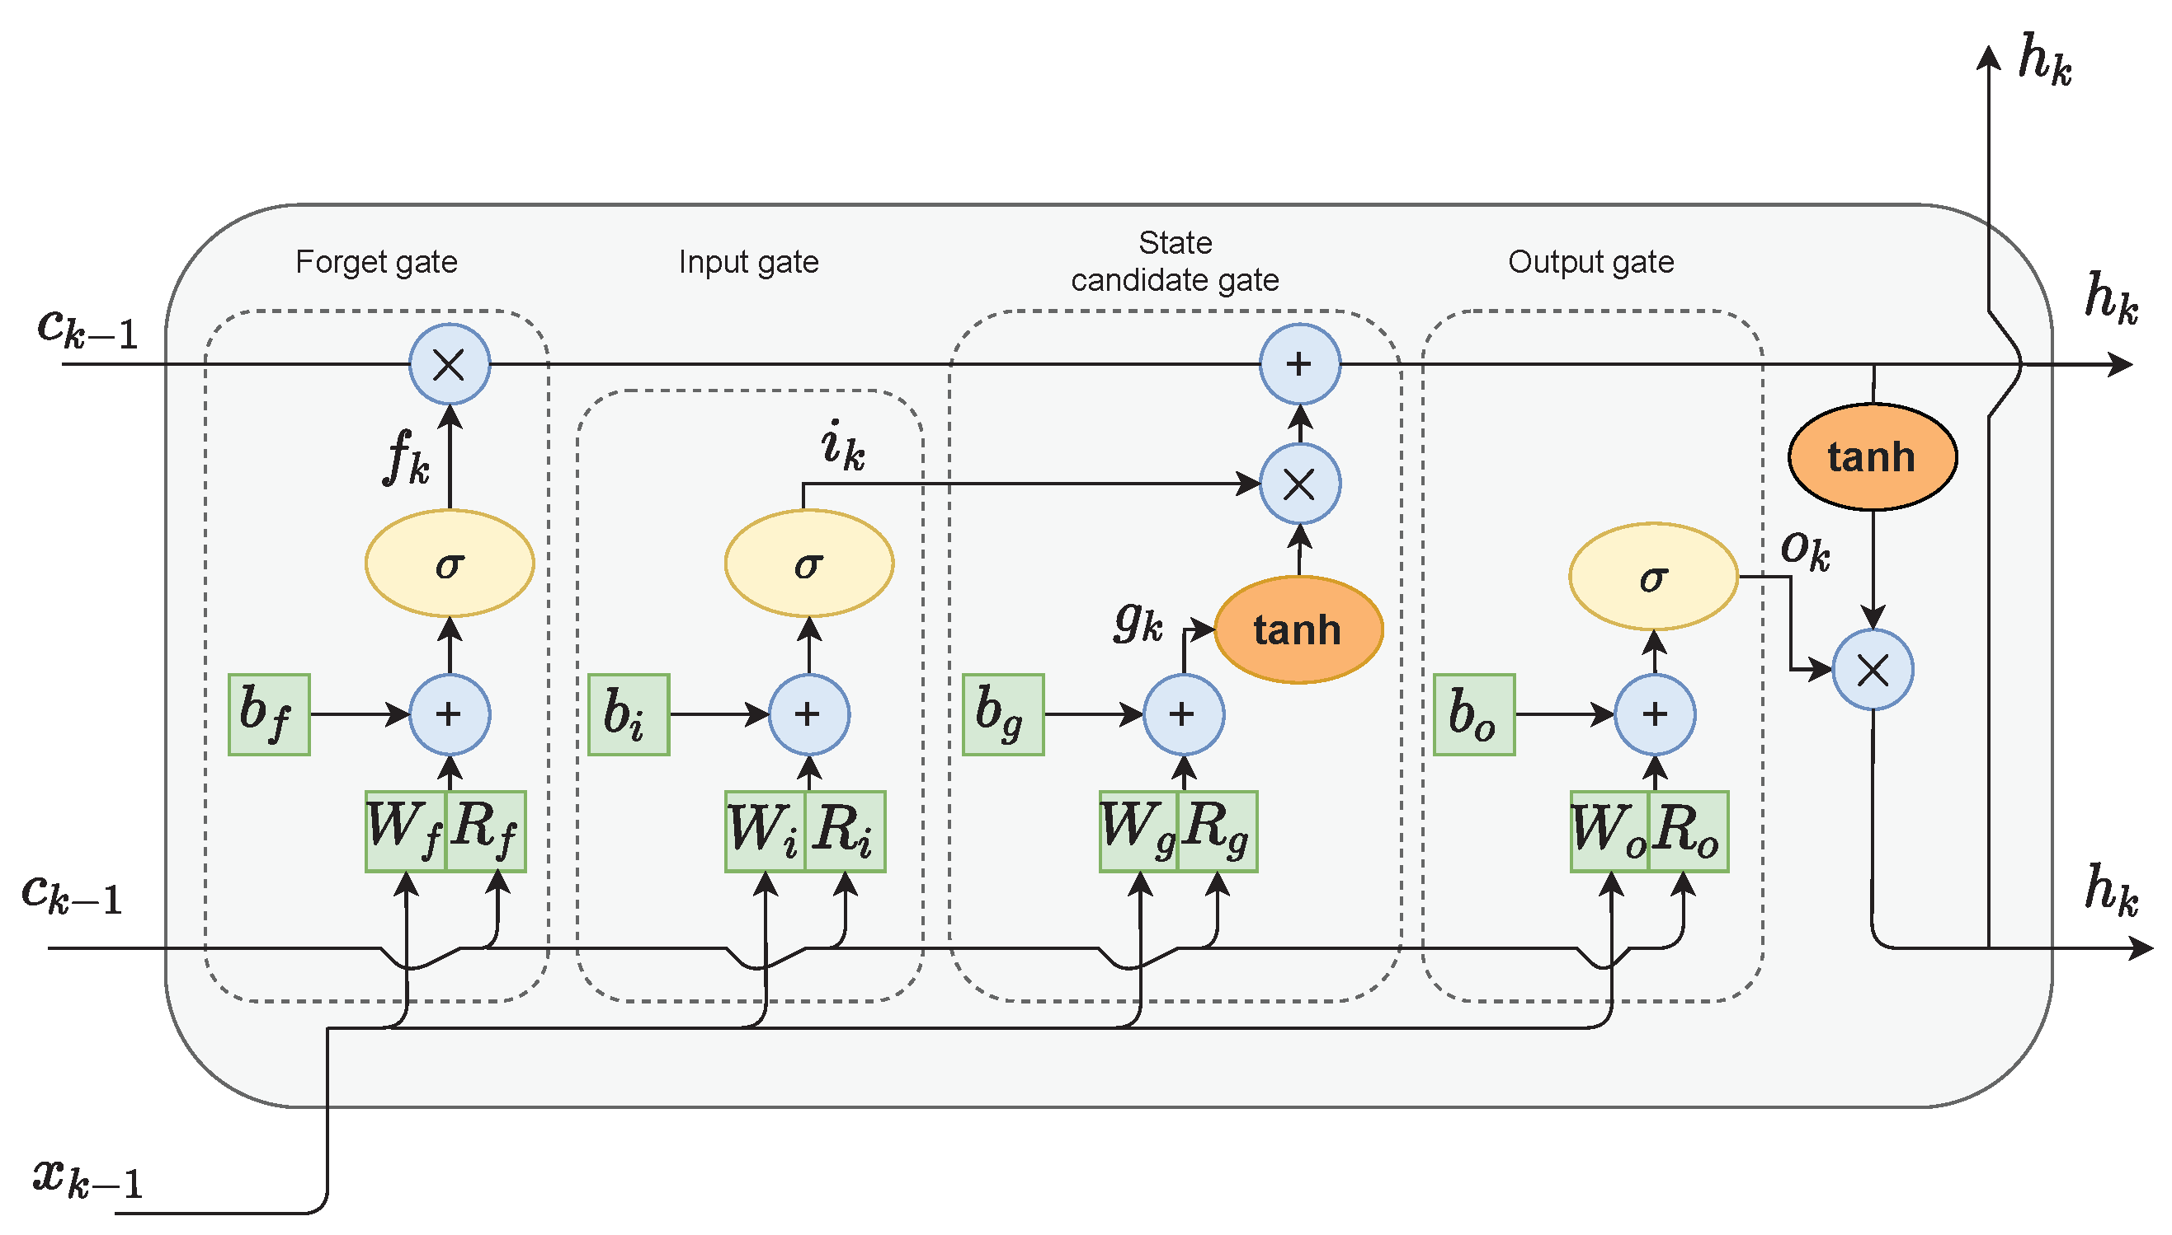
Long Short Term Memory
How to solve the vanishing gradient problem in RNN?
Notes:
: While RNNs theoretically seem perfect for sequence data, they struggle with long-term dependencies due to the 'vanishing gradient' problem. This refers to the issue where the contribution of information decays geometrically over time, making the learning of long-term dependencies practically impossible.

Slide 31
Coding Task 2: Next Frame Prediction

Slide 32
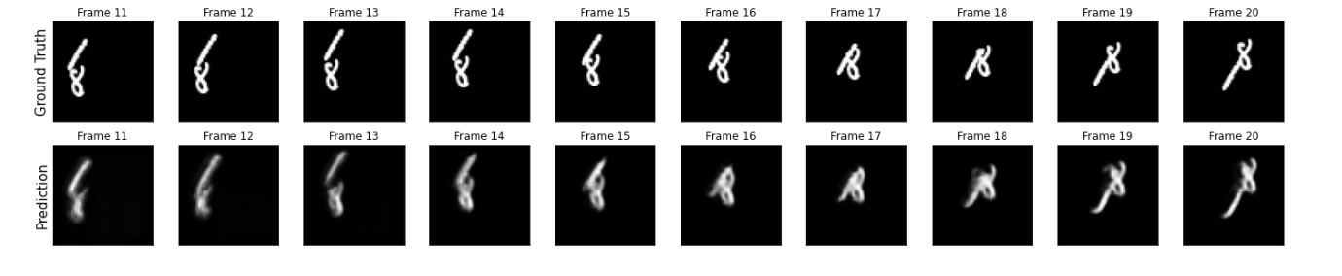
Next Frame Video Prediction Example
Given a sequence of video frames, the model's objective is to predict the subsequent frame accurately. This is akin to forecasting the immediate future in a video sequence.
Challenges: Variations in motion and appearance, Handling complex dynamics
Precautions: Data Quality and Adequate Temporal Span.
Notes:
The model must account for a variety of motions and appearance changes that could occur from one frame to the next. : Video sequences can exhibit complex, non-linear dynamics, making accurate prediction challenging.

Slide 33
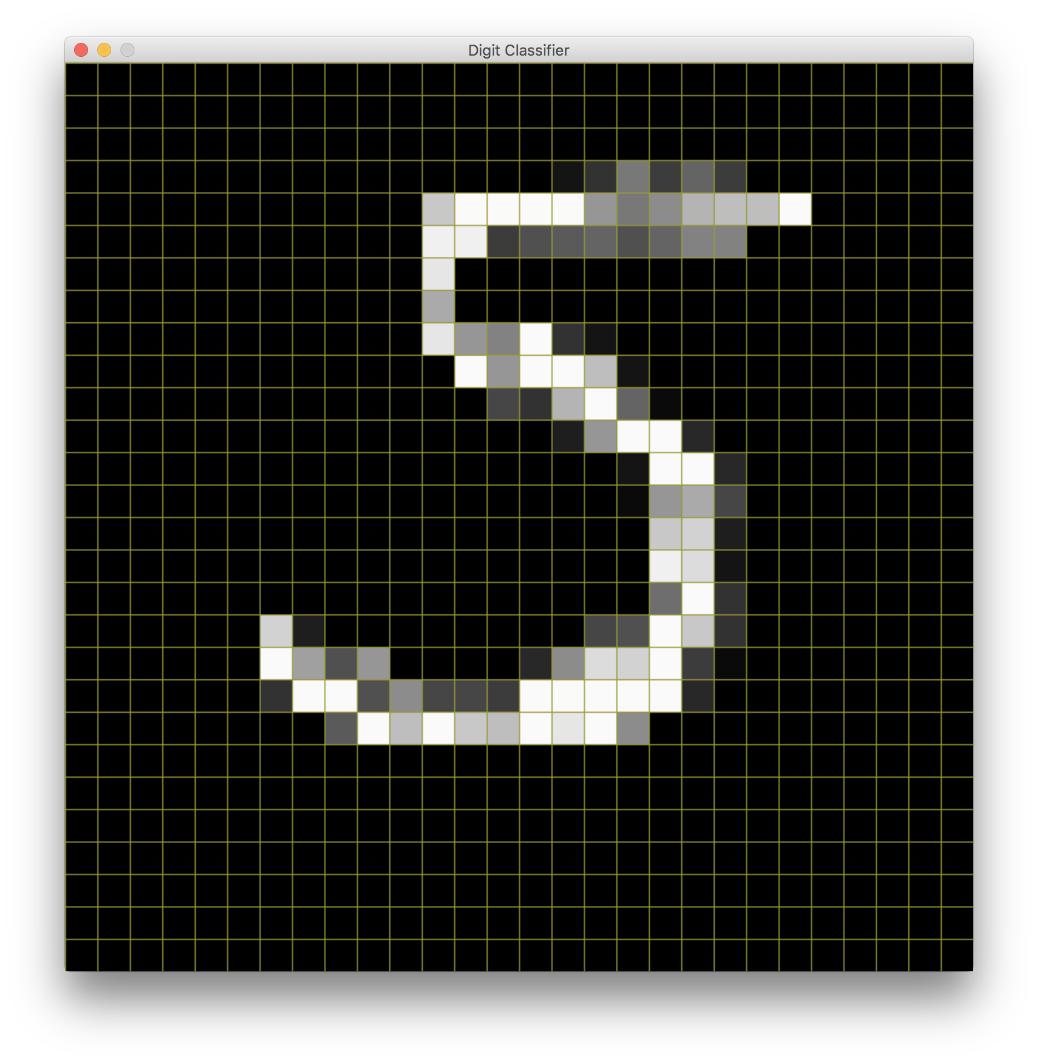
Data Set
Moving MNIST Dataset: The Moving MNIST dataset, which includes sequences of frames where digits move across the frame, is used for this task.
Dataset Characteristics: a time series of images. Each video sequence exhibits temporal dependencies, with the digit's position and appearance changing over time.
Preprocessing: create 'shifted' input-output pairs where each input frame x_n is paired with the subsequent frame y_(n + 1) to teach the model to predict future frames from the given sequence

Slide 34
Code Example
The neural network for next-frame prediction is built using Keras.
The architecture includes convolutional LSTM layers designed to handle sequential image data.

Slide 35

Part 3: Deep Learning in Medical Research Applications

Slide 36
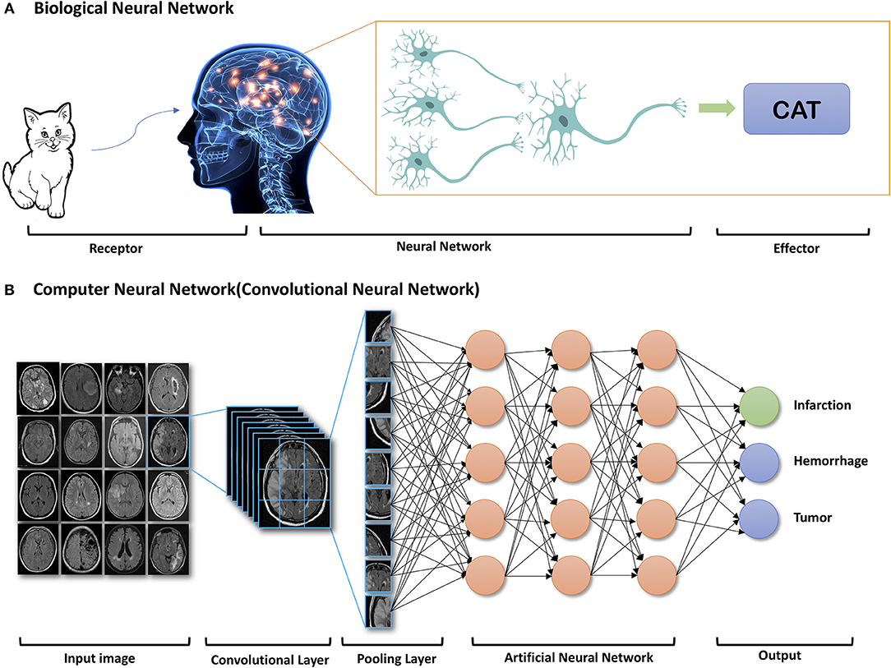
Image Data in Medical Research
Medical imaging techniques: MRI, CT scans, X-rays
Disease detection and diagnosis
Patient monitoring
CNNs applications in medical research
This Photo by Unknown Author is licensed under CC BY
Notes:
Introduce the use of image data in medical research.
Describe some common medical imaging techniques, such as MRI, CT scans, and X-rays.
Explain how image data can help in disease detection, diagnosis, and patient monitoring.

Slide 37
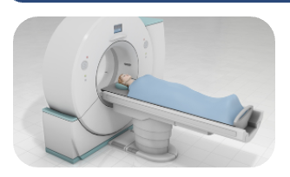
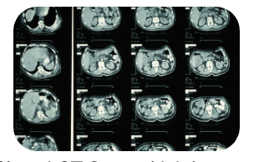
Low Dose Computed Tomography Denoising
Course Project by Zou and Zhang in 2022 Fall.
Computed Tomography (CT) is a medical screen tool using X-ray technology to produce high-quality cross-sectional images of the body.
Radiation toxicity of CT scans can cause radiation syndrome, radiation poisoning and increases the risk of developing fatal cancer.
Compared with Full-dose CT (FDCT) at a regular dose level, Low-dose CT (LDCT) lowers the radiation exposure significantly. However, LDCT scans are often too noisy for diagnostic use.
Apply computational denoising methods in multiple approaches to increase the rate of LDCT adoption.

Slide 38
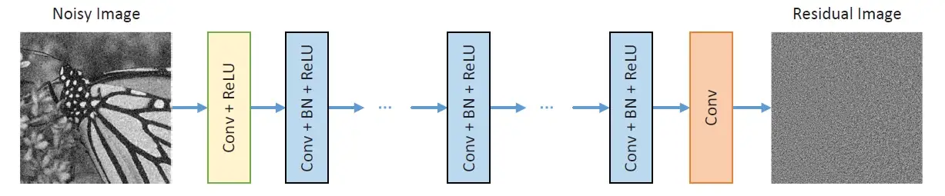
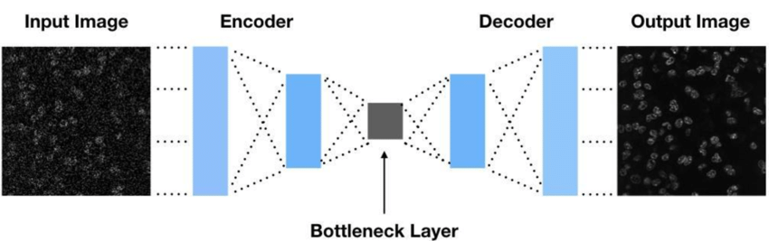
LDCT Method
DnCNN
AutoEncoder

Slide 39
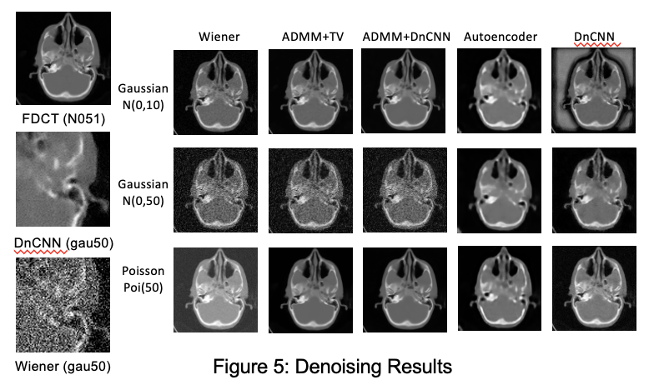
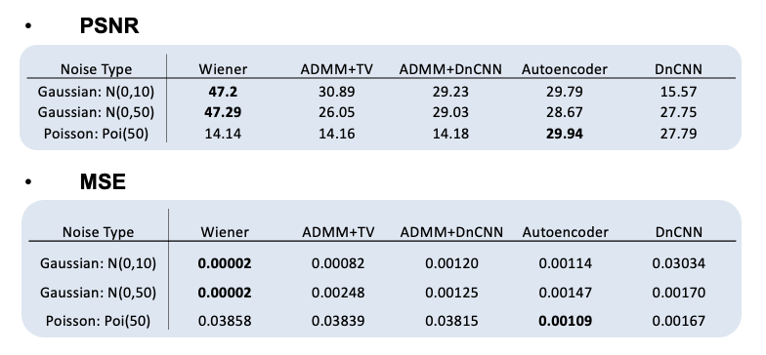
LDCT Result

Slide 40
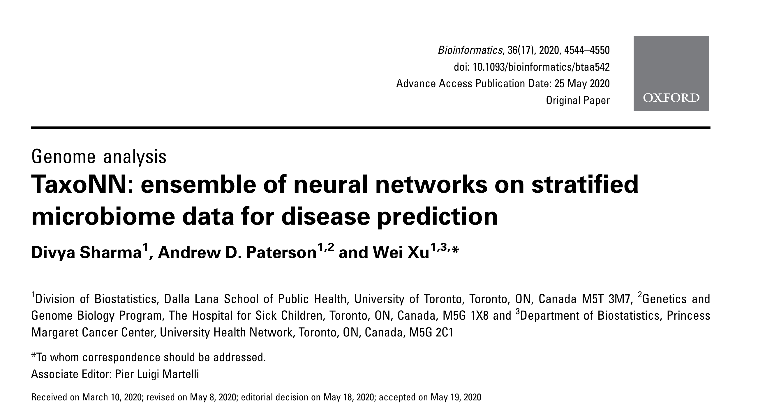
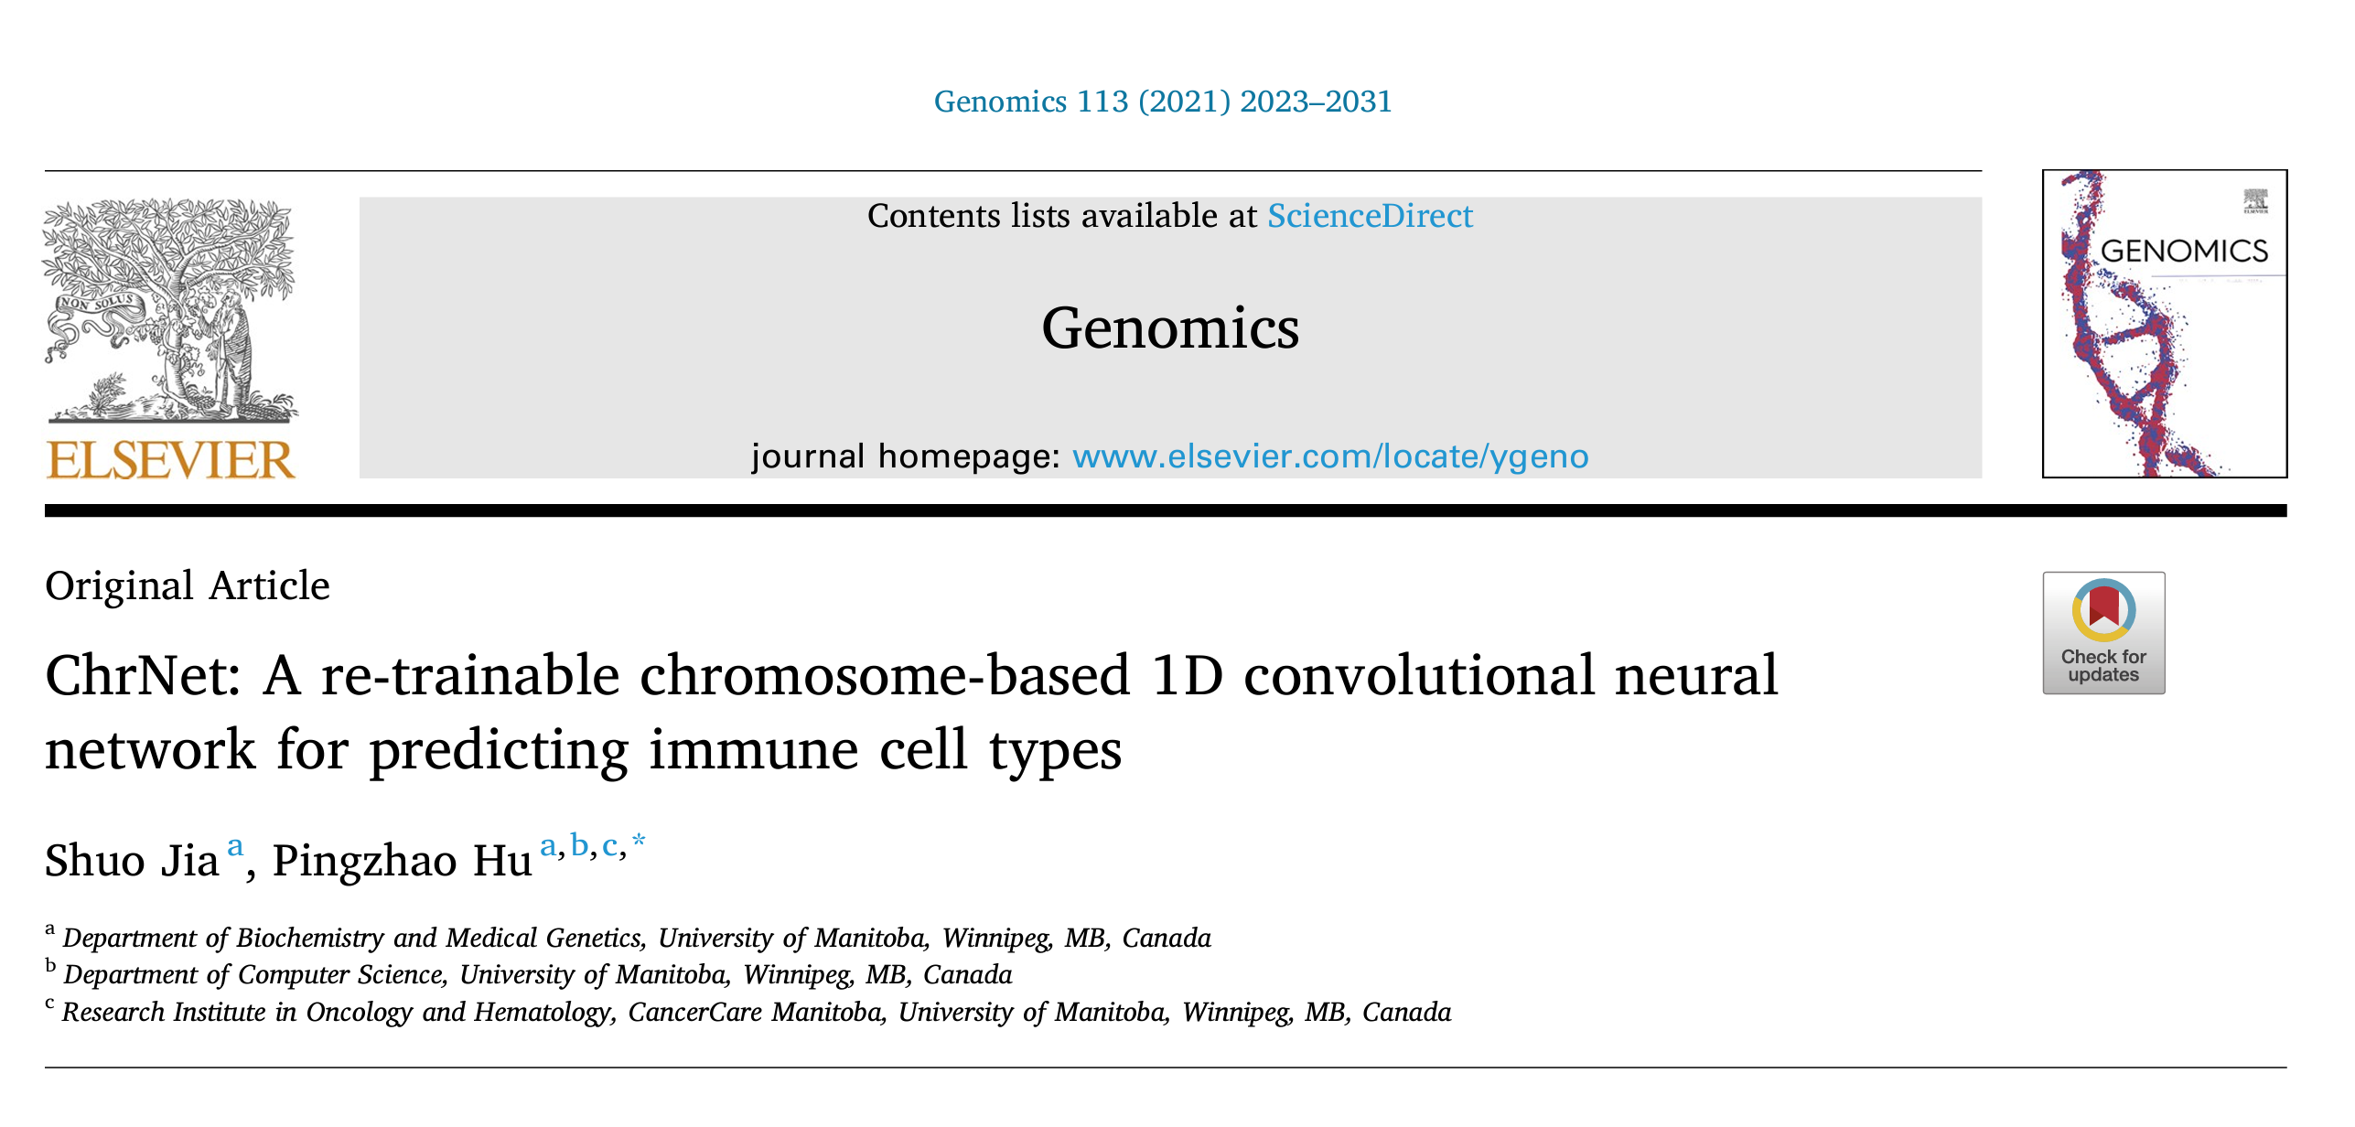
CNNs in Genomics and Microbiome Data
Notes:
Introduce the use of image data in medical research.
Describe some common medical imaging techniques, such as MRI, CT scans, and X-rays.
Explain how image data can help in disease detection, diagnosis, and patient monitoring.

Slide 41

Data and Outcomes
Genomics:
Gene Expression (scRNA--seq)
Cell type multi-class classification
Microbiome:
microbial Operational Taxonomic Units (OTUs)
Type 2 diabetes (T2D) binary classification
Notes:
Introduce the use of image data in medical research.
Describe some common medical imaging techniques, such as MRI, CT scans, and X-rays.
Explain how image data can help in disease detection, diagnosis, and patient monitoring.

Slide 42
What are the Spatial Correlations?
Genomics - ChrNet Approach:
Input: Gene by cell matrix with TPM (Transcripts Per Million) expression values.
Gene Alignment: Values are aligned based on their linear positions on the human genome reference (hg19). Early starting position genes are prioritized when considering overlaps.
Key Insight: Genes adjacent on the same chromosome exhibit similar expression patterns - beneficial for feature extraction.
Microbiome - TaxoNN Approach:
The basis of correlation: Operational Taxonomic Units (OTUs) at the same taxonomy level inherently share correlations.
Key Insight: Non-linear relationships exist between OTUs, especially evident during disease prediction.

Slide 43
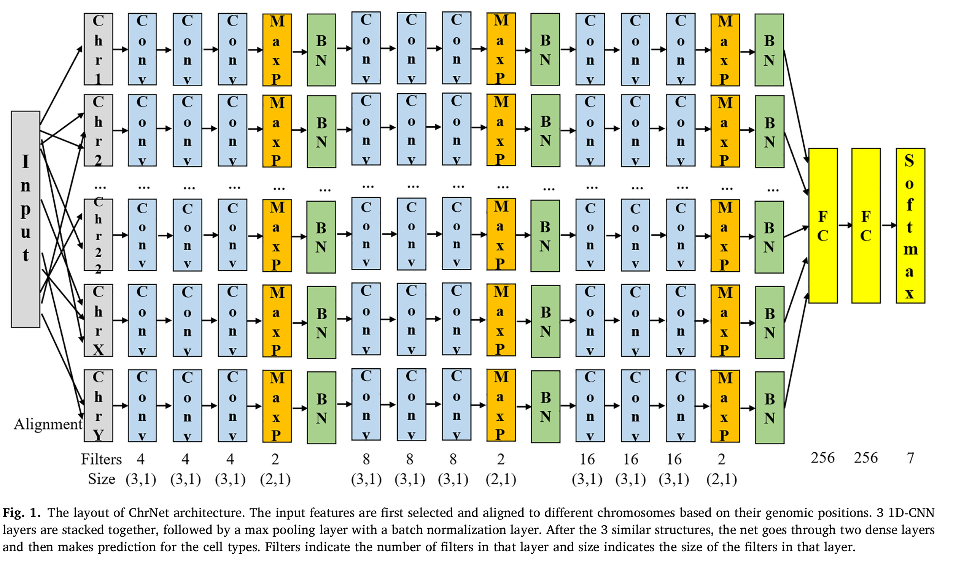
ChrNet
Notes:
Introduce the use of image data in medical research.
Describe some common medical imaging techniques, such as MRI, CT scans, and X-rays.
Explain how image data can help in disease detection, diagnosis, and patient monitoring.

Slide 44
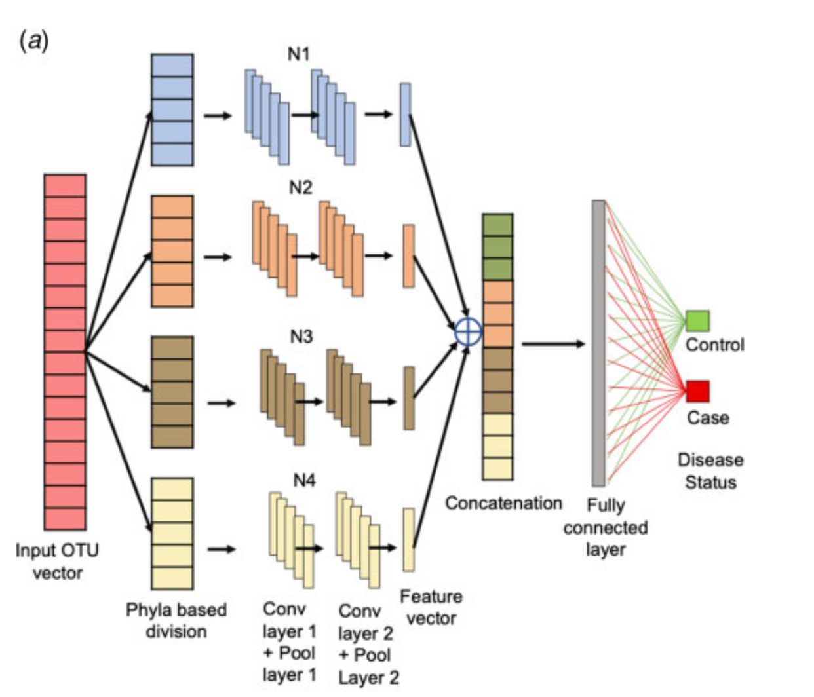
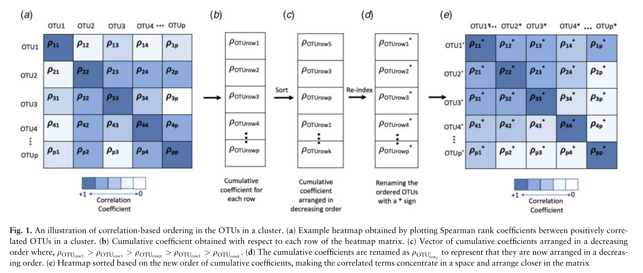
TaxoNN
Notes:
Introduce the use of image data in medical research.
Describe some common medical imaging techniques, such as MRI, CT scans, and X-rays.
Explain how image data can help in disease detection, diagnosis, and patient monitoring.

Slide 45

Build Your Deep Learning Skills
Math Skills: Calculus, Linear Algebra, Statistics
Programming Skills: Python, R, MATLAB, (SAS?)
Interview Questions list is a good guide to Learn key concepts
Research Projects

Slide 46
Q and A

Slide 47
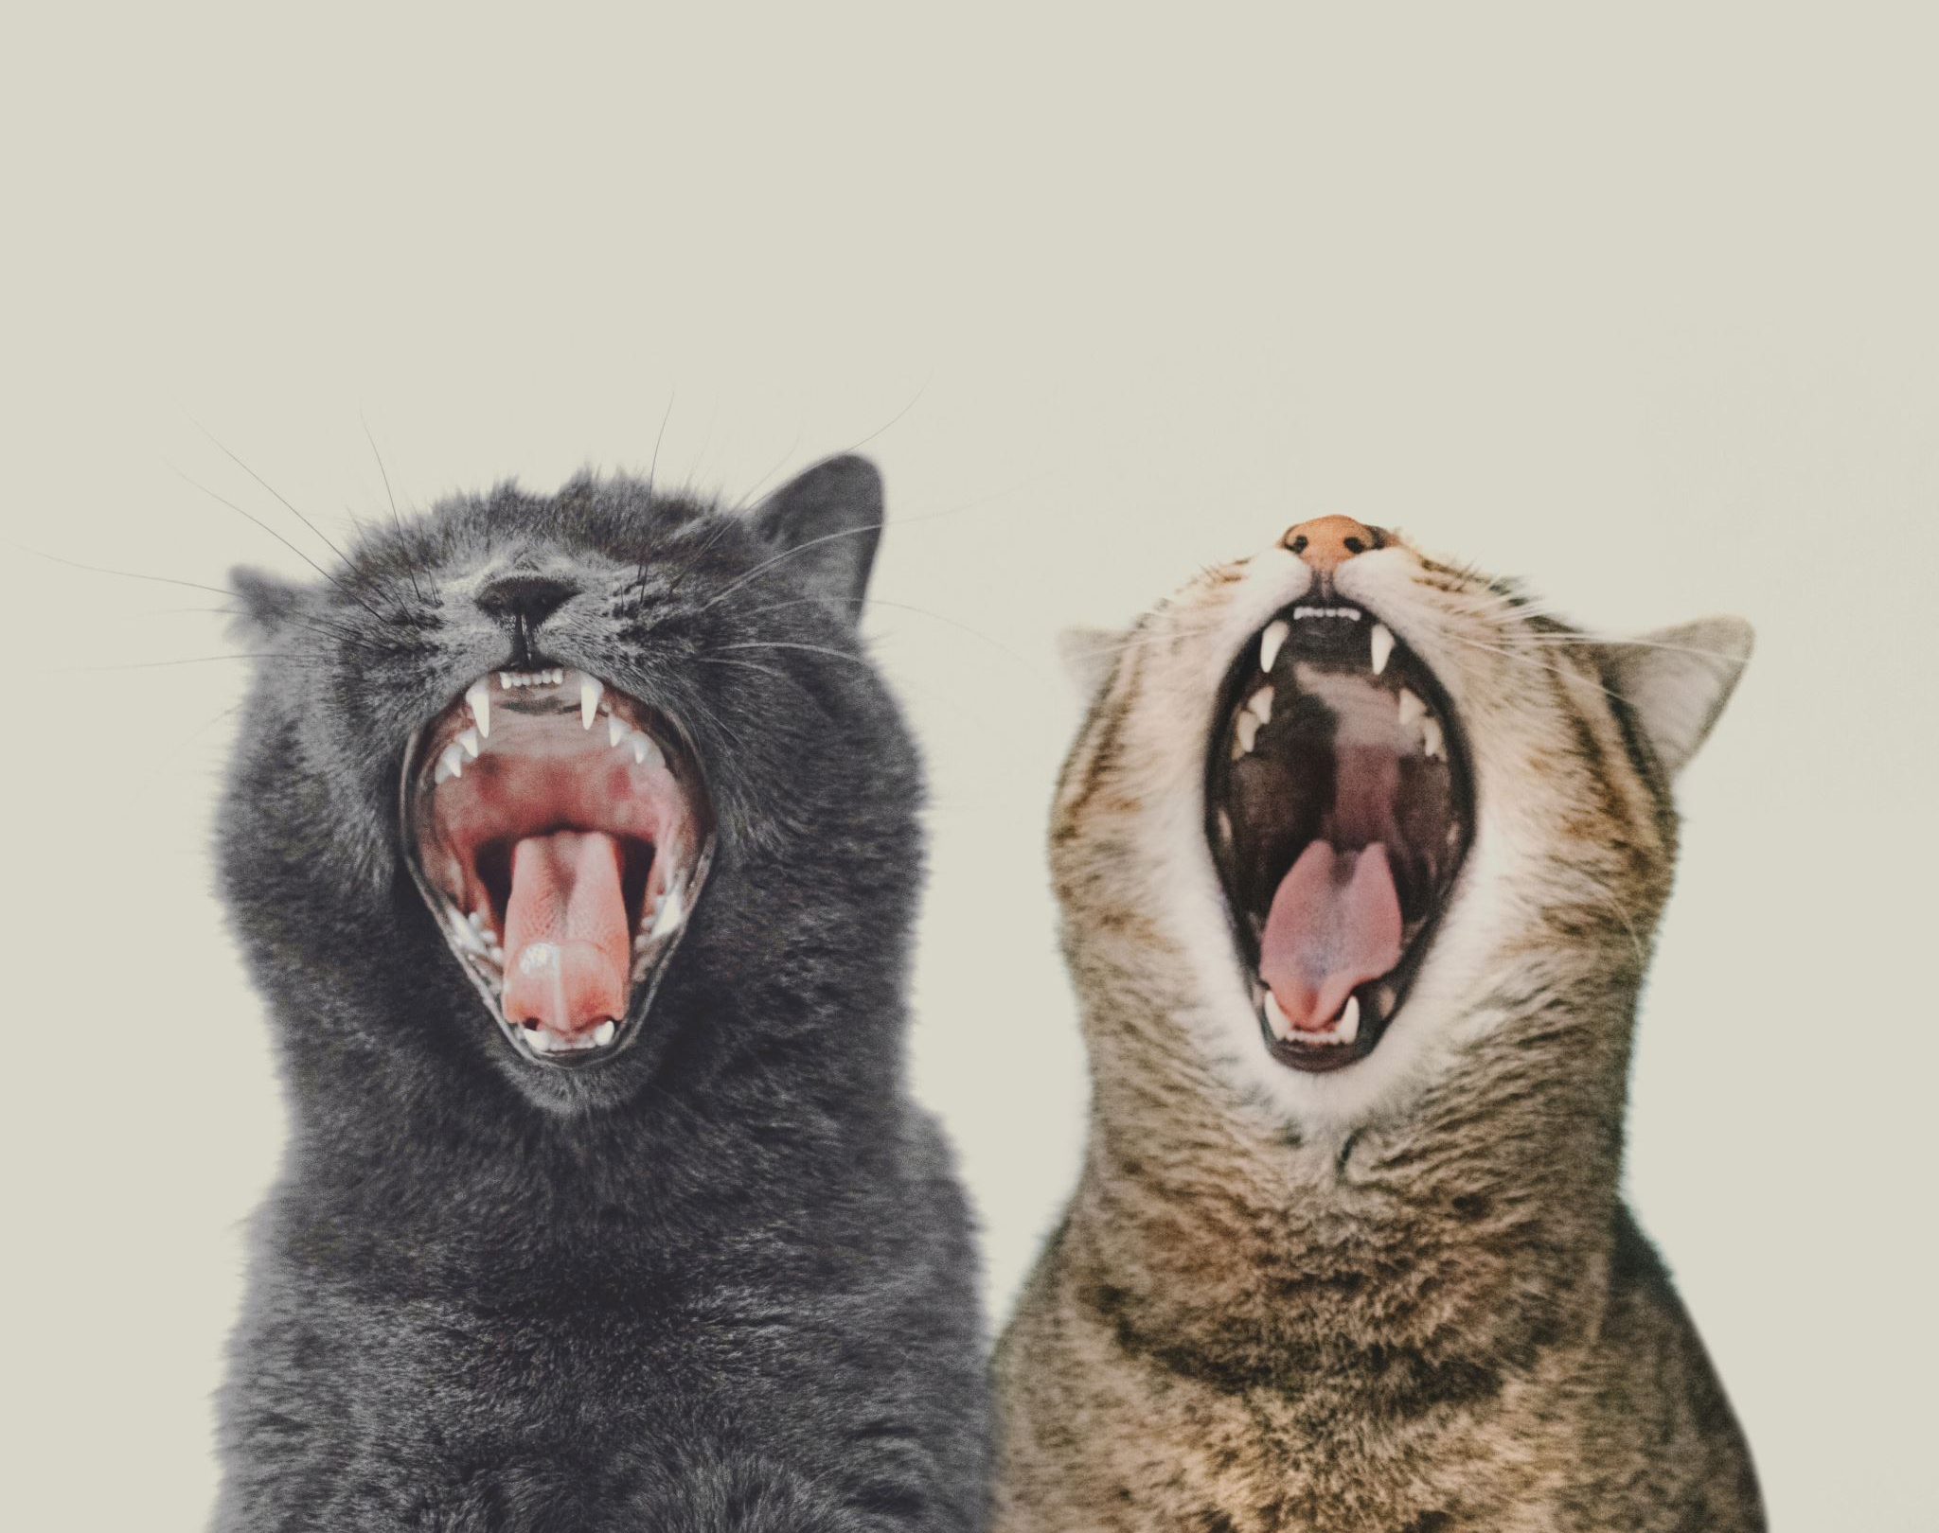
Acknowledgement
VADA Program
Dr. Pingzhao Hu
Health Data Working Group, DLSPH, University of Toronto
Xu Lab, Biostatistics Department, University Health Network
Keras team and code example authors: François Chollet, Amogh Joshi

Slide 48



Health Data Working Group
The Health Data Working Group is an initiative led by members of the Dalla Lana School of Public Health community to facilitate the uptake of programming-related tools for the benefit of public health research.

Slide 49
References
Chollet, F. (2022, November 10). Keras documentation: Image Classification From Scratch. Keras. https://keras.io/examples/vision/image_classification_from_scratch/
Hochreiter, S., &amp; Schmidhuber, J. (1997). Long short-term memory. Neural Computation, 9(8), 1735–1780. https://doi.org/10.1162/neco.1997.9.8.1735
Jia, S., &amp; Hu, P. (2021). ChrNet: A re-trainable chromosome-based 1d convolutional neural network for predicting immune cell types. Genomics, 113(4), 2023–2031. https://doi.org/10.1016/j.ygeno.2021.04.037
Joshi, A. (2021, June 5). Keras Documentation: Next-frame video prediction with convolutional lstms. Keras. https://keras.io/examples/vision/conv_lstm/
Parkhi, O. M., Vedaldi, A., Zisserman, A., &amp; Jawahar, C. V. (2012). Cats and dogs. 2012 IEEE Conference on Computer Vision and Pattern Recognition. https://doi.org/10.1109/cvpr.2012.6248092
Ramachandran, P., Zoph, B., &amp; Le, Q. V. (2017, October 27). Searching for activation functions. arXiv.org. https://arxiv.org/abs/1710.05941
Sharma, D., Paterson, A. D., &amp; Xu, W. (2020). Taxonn: Ensemble of Neural Networks on stratified microbiome data for disease prediction. Bioinformatics, 36(17), 4544–4550. https://doi.org/10.1093/bioinformatics/btaa542
Sherstinsky, A. (2020). Fundamentals of Recurrent Neural Network (RNN) and long short-term memory (LSTM) network. Physica D: Nonlinear Phenomena, 404, 132306. https://doi.org/10.1016/j.physd.2019.132306

